Slide 1

GENERATIVE ADVERSARIAL NETWORK-GAN
Members
2254261005-SAMIA AHMED
2254261023-MD. APPEL MAHMUD PRANTO 2254261022-SHBIRUZZAMAN SHIAM

Slide 2
Presentation Outline
INTRODUCTION
Motivation
Understanding
Magic of GANs
ARCHITECTURE
Basic Working Principle
APPLICATIONS
PROS & CONS
CONCLUSION
Variants of GAN
DC GAN

Slide 3
INTRODUCTION
A generative adversarial network is a class of machine learning frameworks designed by Ian Goodfellow and his colleagues in June 2014. Two neural networks contest with each other in the form of a zero-sum game, where one agent's gain is another agent's loss.

Slide 4
GANs
• Generative
Learn a generative model
• Adversarial
Trained in an adversarial setting
• Networks
Use Deep Neural Networks

Slide 5
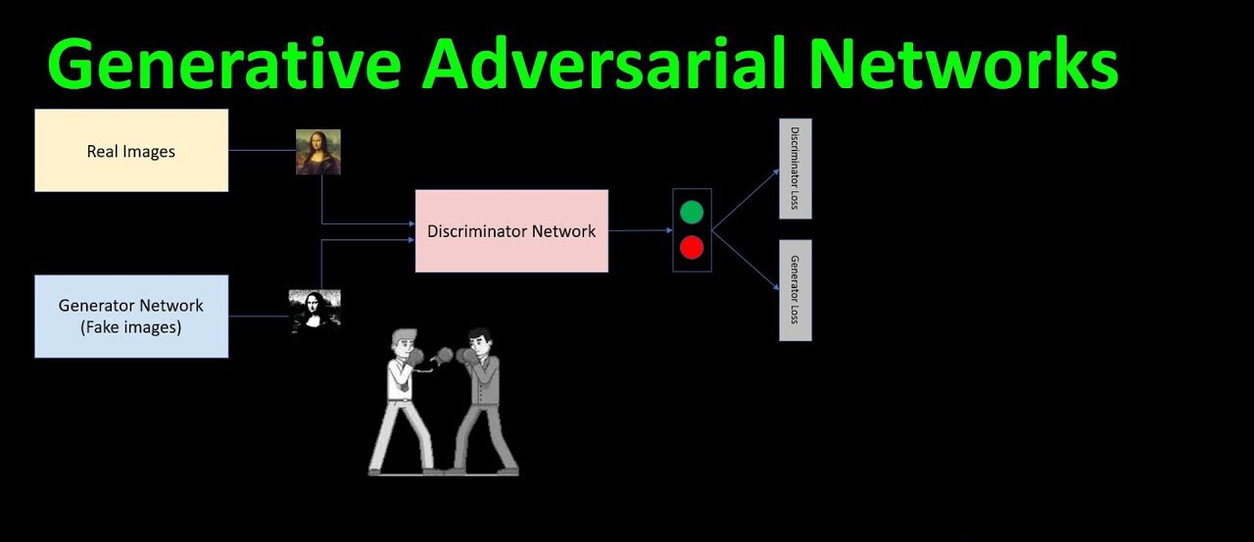

Slide 6
GAN
Generator : Model that is used to generate new plausible examples from the problem domain.
Discriminator : Model that is used to classify examples as real (from the domain) or fake (generated).

Slide 7
Why Generative Adversarial Network?
Image Super-Resolution : The ability to generate high-resolution versions of input images.
Creating Art : The ability to great new and artistic images, sketches, painting, and more.
Image-to-Image Translation : The ability to translate photographs across domains, such as day to night, summer to winter, and more.

Slide 8
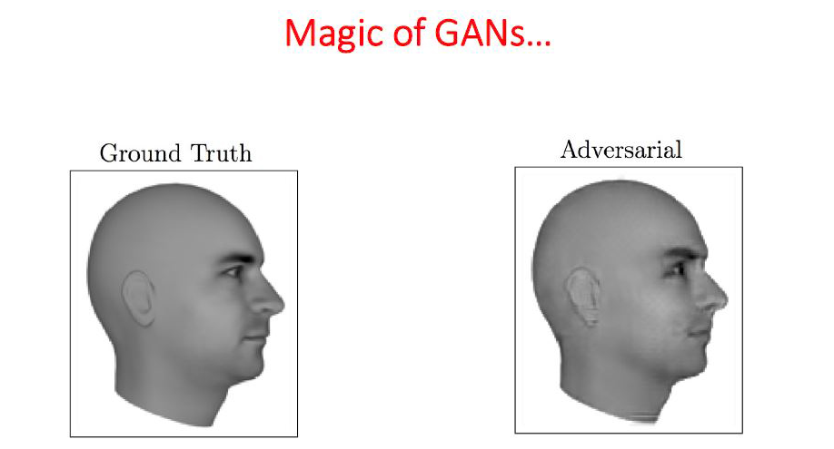

Slide 9
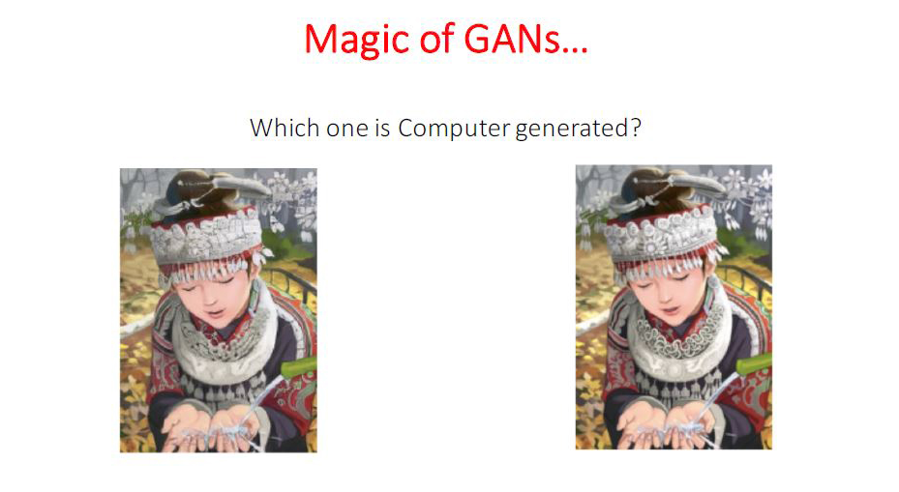

Slide 11
Generative Adversarial Network Architecture

Slide 12
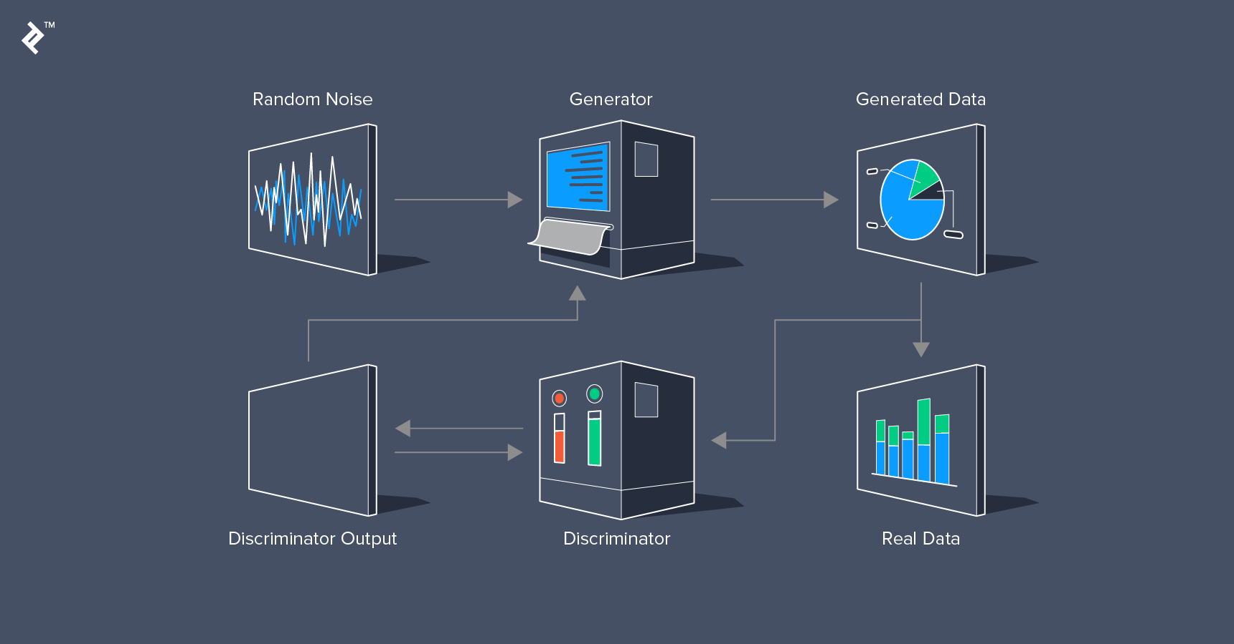
Generative Adversarial Network Architecture

Slide 13
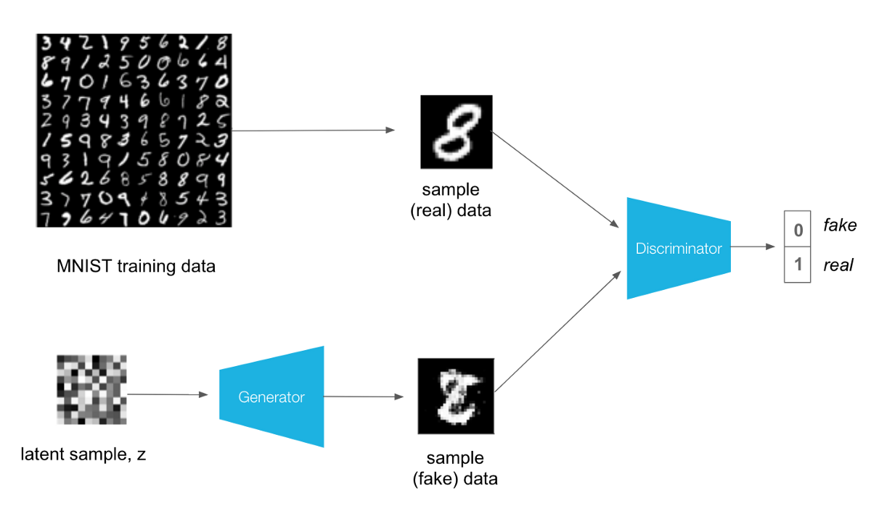
Generative Adversarial Network Architecture

Slide 14
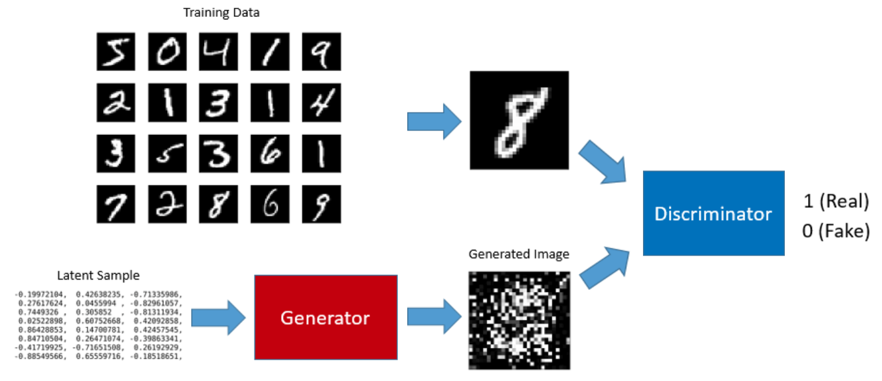
Generative Adversarial Network Architecture

Slide 15
Adversarial Training

Slide 16
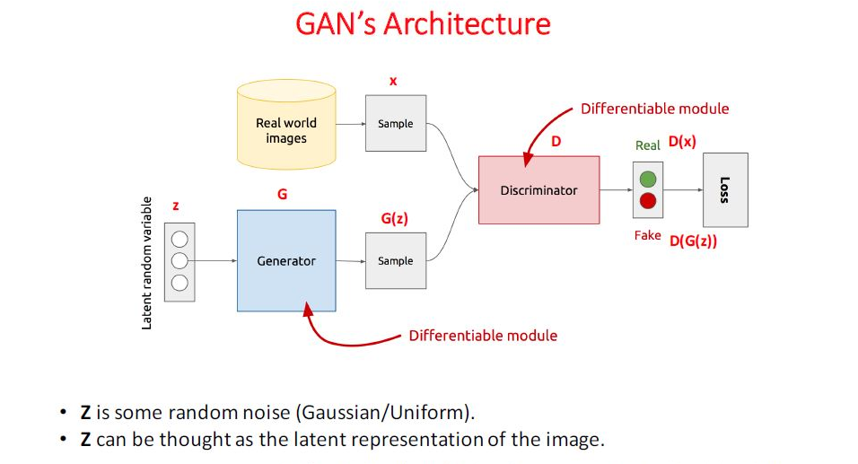
Generative Adversarial Network Architecture

Slide 17
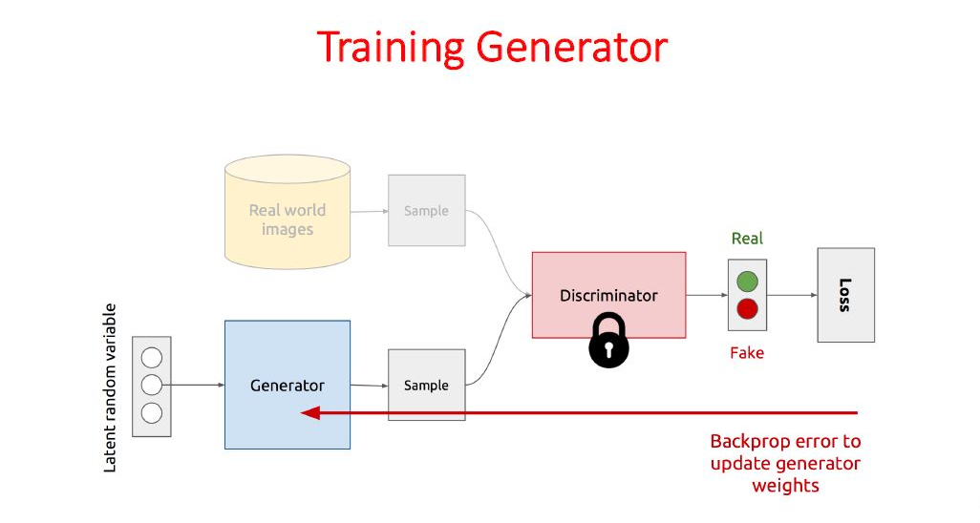
Generative Adversarial Network Architecture

Slide 18
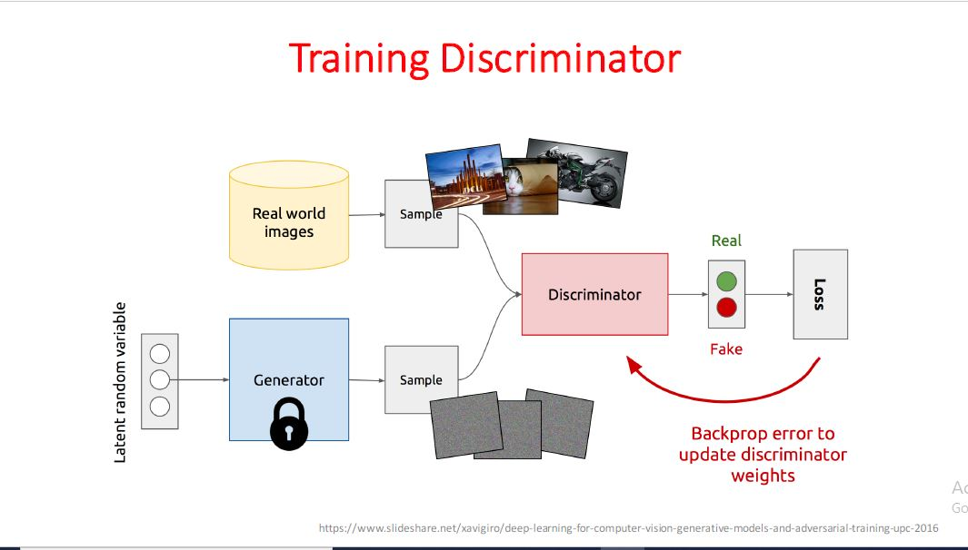
Generative Adversarial Network Architecture

Slide 19
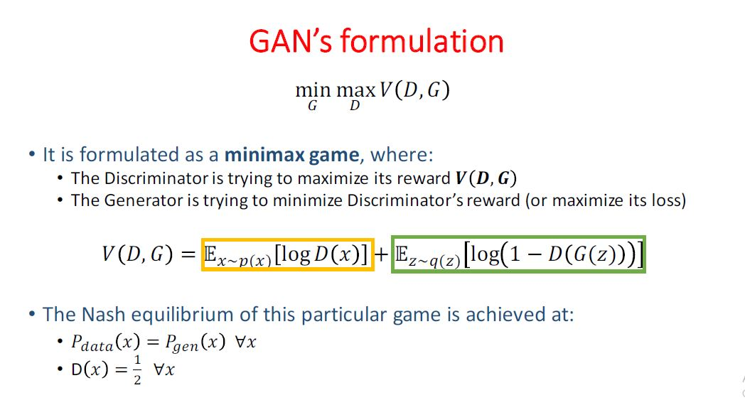
Generative Adversarial Network Architecture

Slide 20
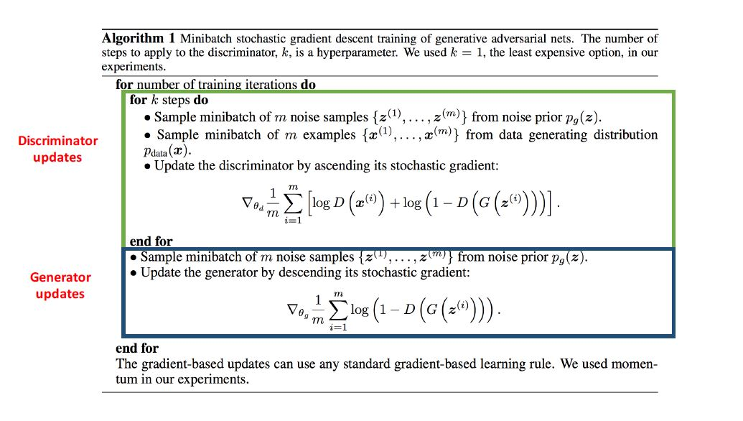
Generative Adversarial Network Architecture

Slide 21
Variants of Generative Adversarial Networks
Vanilla GAN
Conditional Gan (CGAN)
Deep Convolutional GAN (DCGAN)
CycleGAN
Generative Adversarial Text to Image Synthesis
Style GAN
Super Resolution GAN (SRGAN)

Slide 22
Deep Convolutional Generative Adversarial Network

Slide 23
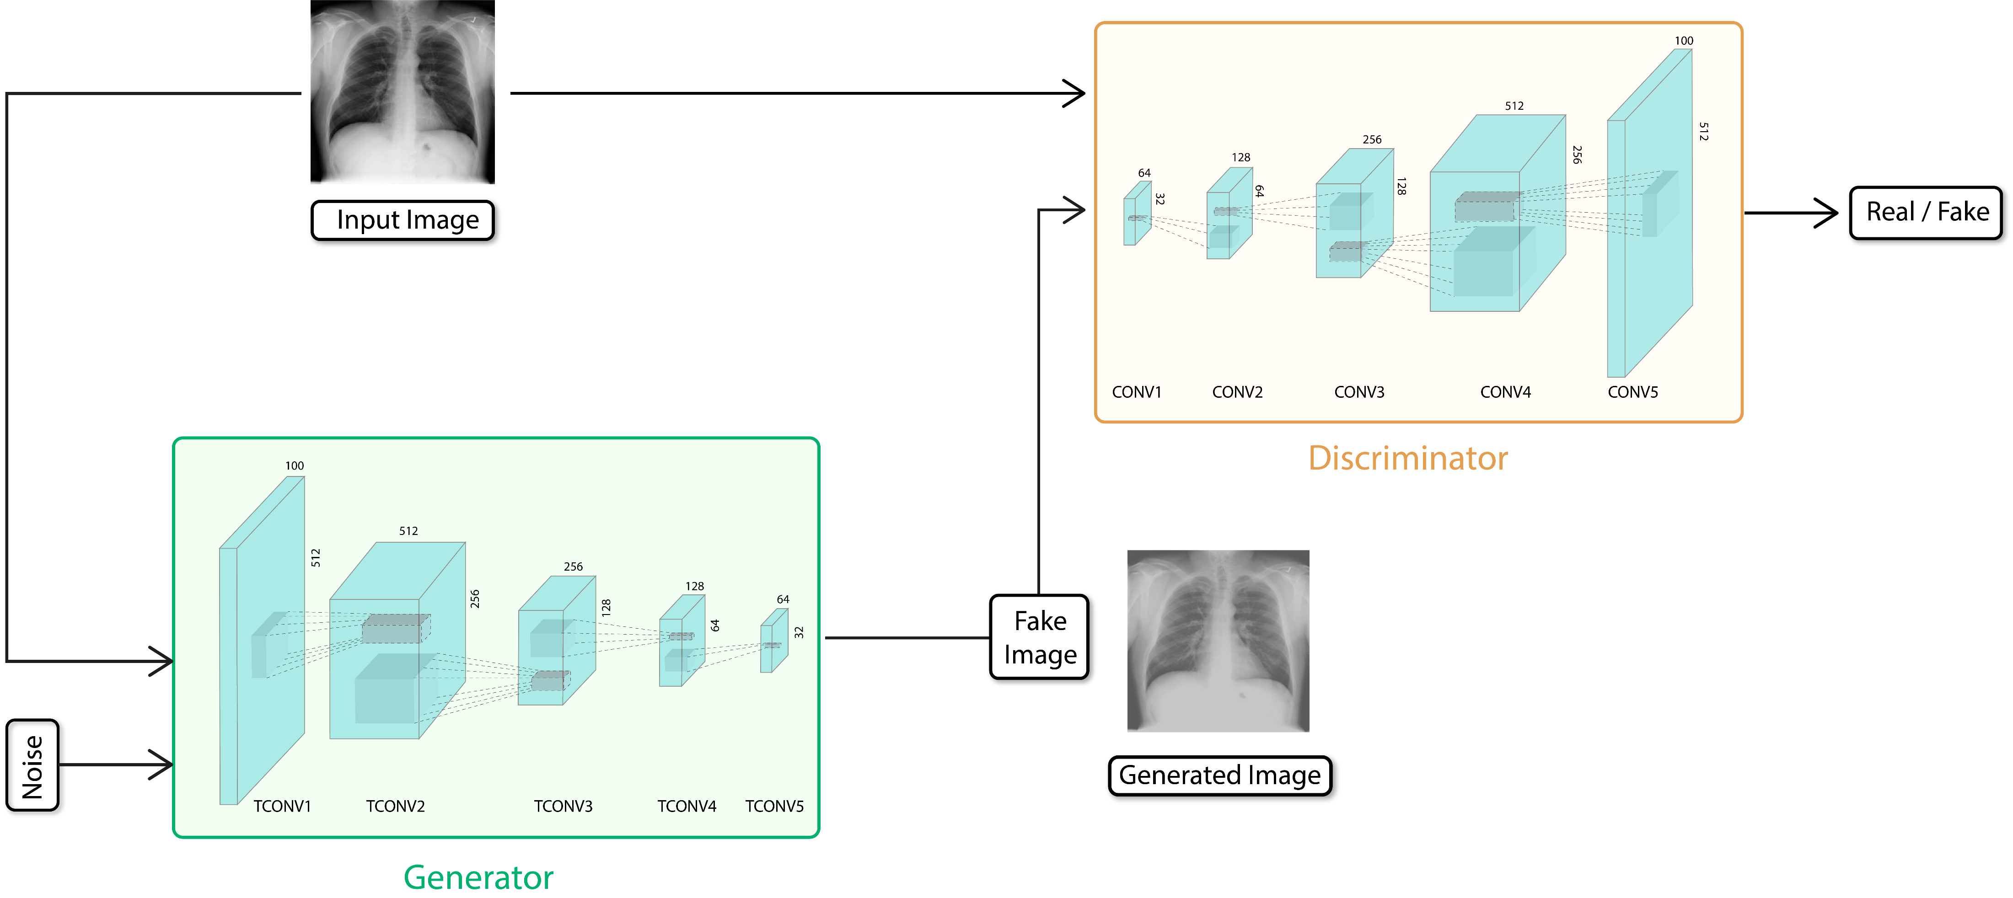

Slide 24
Deep Convolutional Generative Adversarial Network Components
Generator & Discriminator
Latent Vector
Convolutional Layer
Batch Normalization Layer
Leaky ReLu

Slide 25
Applications of Generative Adversarial Networks
Image to Image Translation
Text to Image Translation
Video Generation
Image Augmentation
Photos to Emojis
Face Aging
Image Inpainting
Semantic Image to Photo Translation

Slide 26
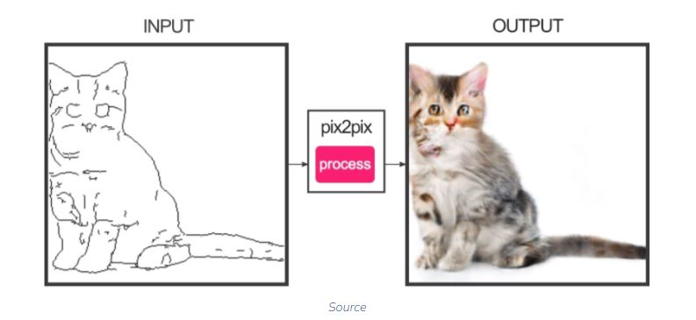
Image to Image Translation (Pix2Pix GAN)

Slide 27
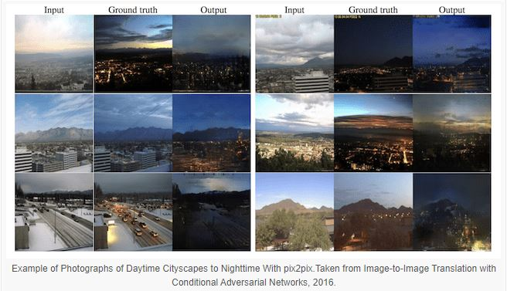
Image to Image Translation (Pix2Pix GAN)

Slide 28
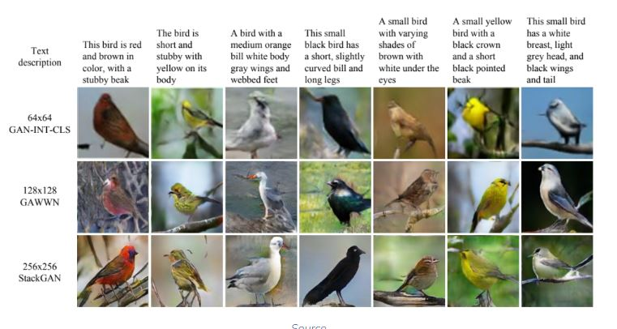
Text to Image Translation (StackGAN)

Slide 29
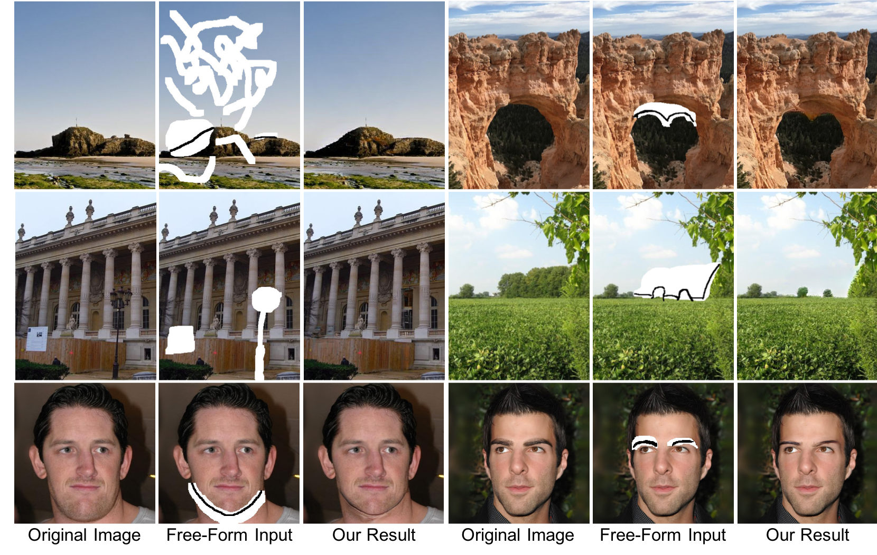
Image Inpainting (MultiGAN)

Slide 30
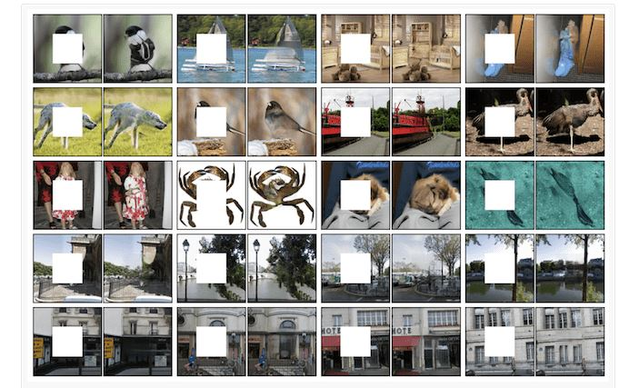
Image Inpainting (MultiGAN)

Slide 31
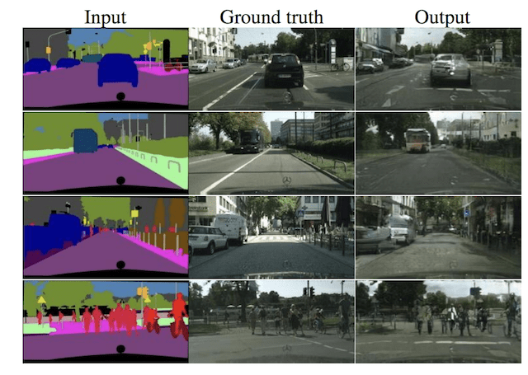
Semantic Image to Photo Translation (ConditionalGAN)

Slide 32
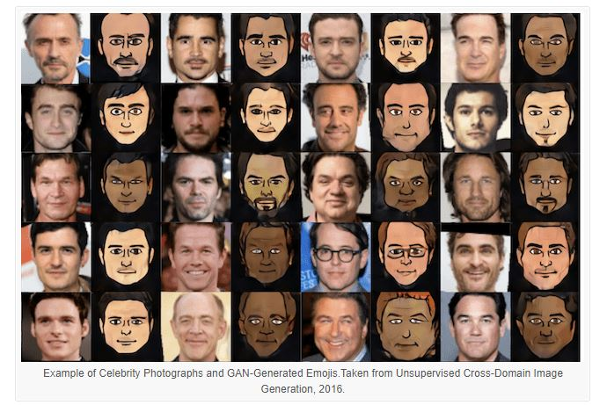
Photos to Emojis (GAN)

Slide 33
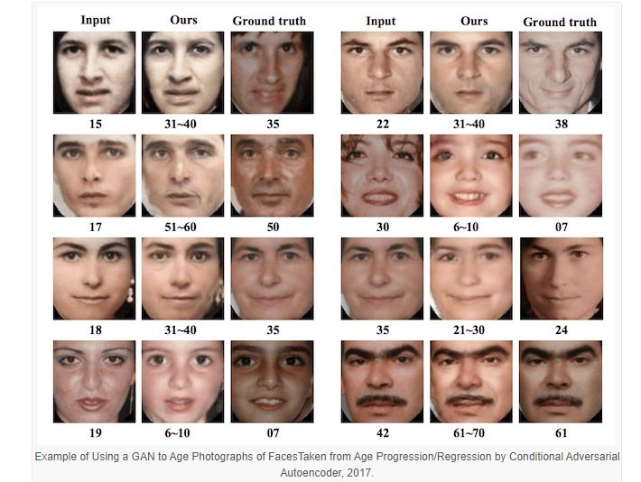
Face Aging (GAN)

Slide 34
Pros of Generative Adversarial Networks
Data labelling is an expensive task. GANs are unsupervised, so no labelled data is required to train them.
GANs currently generate the sharpest images. Adversarial training makes this possible. Blurry images produced by Mean Squared Error stand no chance before a GAN.
Both the networks in GAN can be trained using only backpropagation.

Slide 35
Cons of Generative Adversarial Networks
Harder to train: You need to provide different types of data continuously to check if it works accurately or not.
Generating results from text or speech is very complex

Slide 36
Any
QUESTION?

